Slide 1
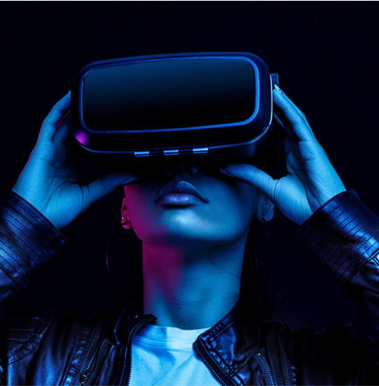

Astral
Branding Across Realities

Slide 2
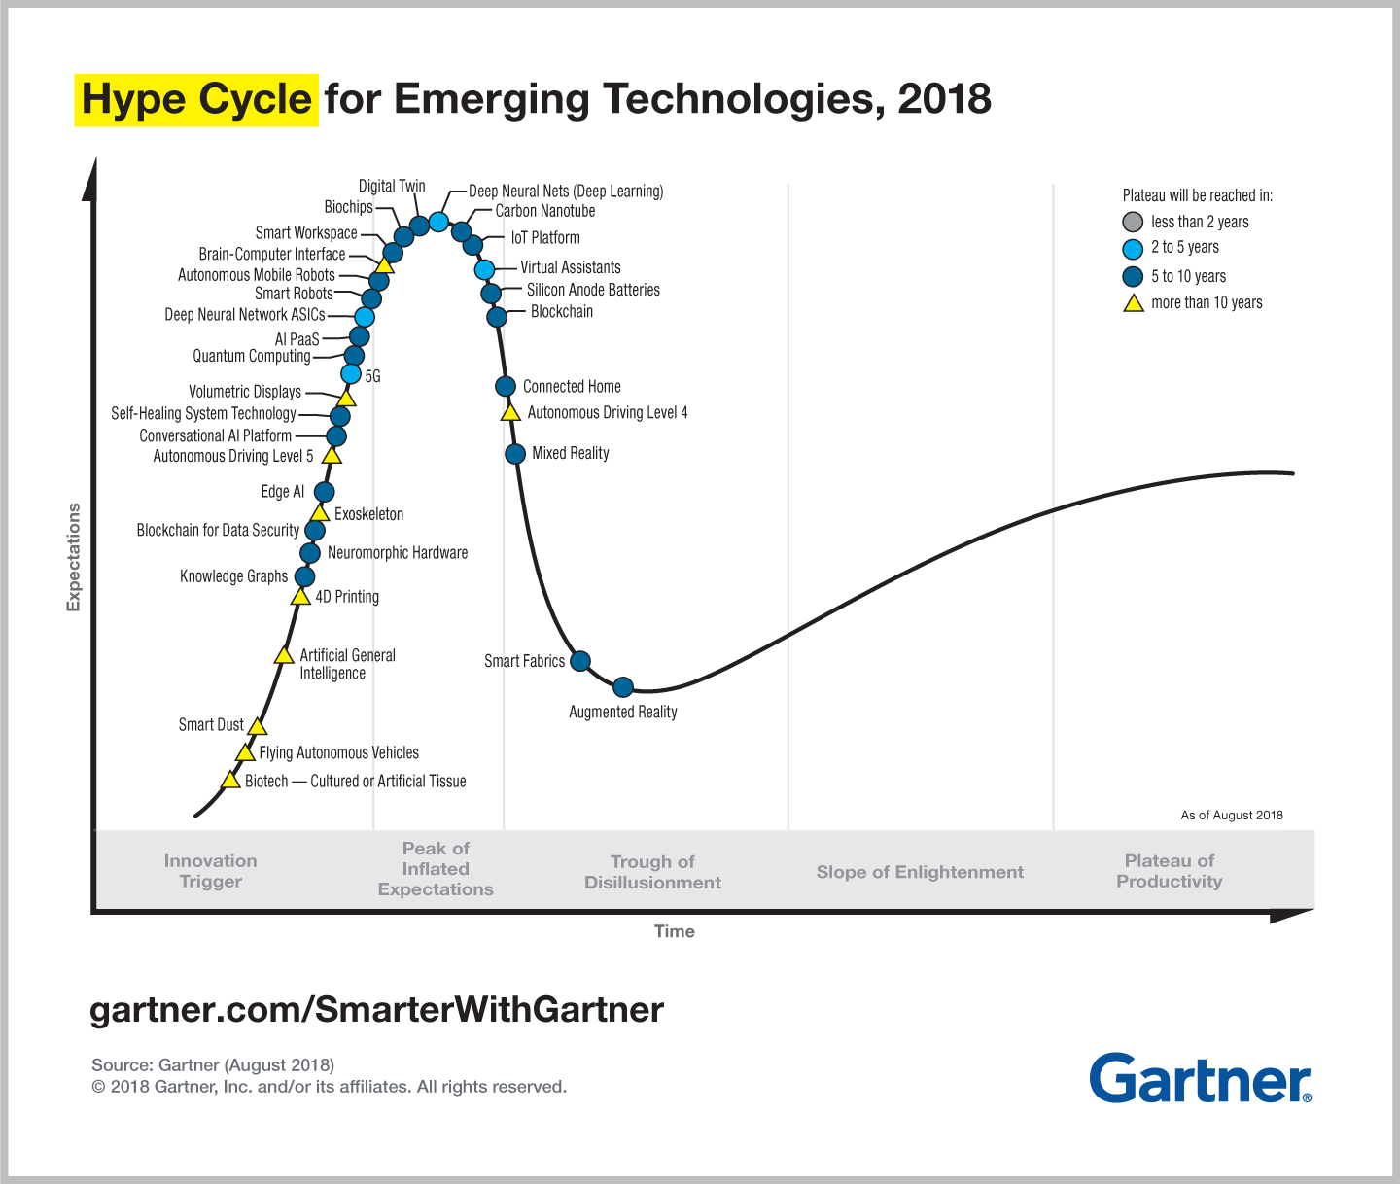
Technology is maturing
Mixed Reality and Metaverse are all set to explode into the plateau of productivity ~2023-2024

Slide 3

Growing Industry Interest

Slide 4







The Metaverse already exists
The internet satisfies all the seven qualities Mathew Ball uses to define the Metaverse
Persistent
Synchronous & Live
No cap on concurrent users
Fully functioning economy
Unprecedented interoperability of assets
User Communities Curate Experiences
Spans both physical & digital worlds
Notes:
We are talking about getting prepared for the Metaverse but the punchline here is that the Metaverse already exists.
And it is the internet. It already has all the 7 elements that the famous silicon valley VC Mathew Ball uses to define the metaverse.
He internet is persistent. The Internet also has no cap to concurrent users, while also providing each user with an individual sense of “presence”
. It already has a mature economy and spans across digital and physical realms. It also to an extent has interoperability of assets, and I’m thinking about cryptocurrencies right now. And lastly, its also populated by “content” and “experiences” created and operated by an incredibly wide range of contributors

Slide 5




Scoping: Criteria
Reach
Technology
User Experience
Cost
Number of impression
Number of unique viewers
Technology Maturity
Adoption
Learning Curve
Interfering advertisements
Distracting advertisements
Cost-to-benefit
Technology expense
User Acquisition
Cost/1000 reach
Notes:
Now that we know that the metaverse is closer than we think it is, we wanted to understand as an advertisement and branding platform, which service to focus on first. To understand that, we ranked potential services based on reach, technological readiness, UX and the cost incurred.

Slide 6
Scoping
Immersive Ads
Event Placements
Digital Banners & Billboards
CONCEPTS
Experience Placements
AI Bot Influencers
Product Placements
Immersive Ads Customers interact with advertisements placed within virtual games
Digital Banners & Billboards Billboards could be placed in virtual workspaces, for all to see
AI Bot Influencers Trained algorithms can maximize followers and display the most relevant content
Product Placements
Placing products in the virtual world to increase its engagement in the real world
Experience Placements A virtual world setup for the brand to advertise, where the customers can actually get immersed in that world and interact with the products of the company
Event Placements Events organized with real celebrities to boost the company’s brand. For instance, Ariana Grande performed for players of the game, Fortnight
Notes:
There were some good candidates that almost made the cut, like displaying billboards in places with high population density. We also thought that AI Bot influencers would be a good idea in terms of tailored content based on historical successes on metrics like click through rate.

Slide 7
Concepts Selection: Conclusion
Immersive-ads in Gaming Immersive advertisements in gaming to be a revolutionary way to capitalize the best of both real and virtual world – in the meta world of tomorrow. Immersive ads will be experienced by the early adopters of the metaverse (gamers) that get introduced to these new and unique styles of advertising immersive through gaming
Notes:
However, our analysis led us to finalizing Immersive Ads in the gaming industry. Not only will it make customers interact with the ads more, it will also be easy to integrate advertisement in the gaming industry, which is already primed for the metaverse. Speaking of which..,

Slide 8


The gaming industry is already “there”
Video games already do what the Metaverse promises: Virtual hangouts, digital currency, weddings and more.
Steam, 2017
Epic Games, 2017
Steam’s VR platform had a home type experience with social features.
Fortnight has partnered with Netflix, Ferrari & more to create assets within the game.
Ubisoft, 2017
Second Life, 2003
Its game, Assassin’s Creed offers convincing historical tours within the game .
Online social platform where people created digital representations of themselves.
Notes:
The next punchline we have for you is that the gaming industry is already THERE. It has already been doing what Zuckerburg and some of the pioneers of the metaverse are promising us.
Steam had already created the idea of a metaverse which it called HOME back in 2017, where users had the ability to experiences myriad of social features.
Fortnight, a game by Epic Games has partnered with companies like Netflix and Ferrari to create digital assets like skins and artifacts.
Ubisoft and Second Life have also given us a glimpse of what our future holds.
Now let’s see who our service is targeted towards.

Slide 9

Persona
Personality
Frustrations
Ambition
Doesn’t have the technology developed to advertise on the metaverse.
Experimenting with advertising would be too expensive if done in-house
Tech-savvy
Creative
Name:
Age:
Education:
Occupation:
Sushant Singh
38
MBA
Marketing Manager, top fashion house
Bio
Goals
Tisha is a marketing manager at a top fashion house that’s looking to leverage the rising popularity of the metaverse by advertising there.
To conceive a competitive & innovative advertising offering in the Metaverse/

Slide 10
Fashion’s foray into the Metaverse
Metaverse
Metaverse
Game development on the metaverse has already began on platforms like Roblox.
Fashion companies are just starting to offer digital experiences & have realized its ability to scale.
Gaming
Fashion
Major Players
Major Players
Epic Games, Unity Software, Magic Leap, Tencent
Gucci, Louis Vuitton, Nike
Initiatives
Initiatives
Nike has created NIKELAND on Roblox for its fans to connect, share experiences and compete.
Louis Vuitton partnered with Riot Games to create skins for League of Legends game.

Slide 11
Revenue
Product Development
• Price = Development + Incentive
• Produce 4 games per year
Consultation
• Price = $130 / hour
• One consultation = 12 hours
• 48 consultation per years
Service | Dev. | Cost per visit | # visits per game | # games per year | Revenue
Prod Dev | $50,000 | $1 | 200000 | 4 | $1,000,000
Service | Hourly rate | Hours per consulting | # consulting per year | Revenue
Consulting | $130 | 12 | 48 | $74,880

Slide 12
Cost
Wage
• Our team consists of 6 people
• Salary per head: $100,000
Publishing
• Advertising to attract more users
• Daily advertising rate: $23
Other expense
• Office rent, software, admin stuffs
• $1800 per head per month
Category | Unit cost | # of unit | Cost
Wage | $100,000 | 6 people | $600,000
Publishing | $23 | 14 days * 4 games | $9,365
Others | $1,800 | 6 people * 12 month | $100,800

Slide 13
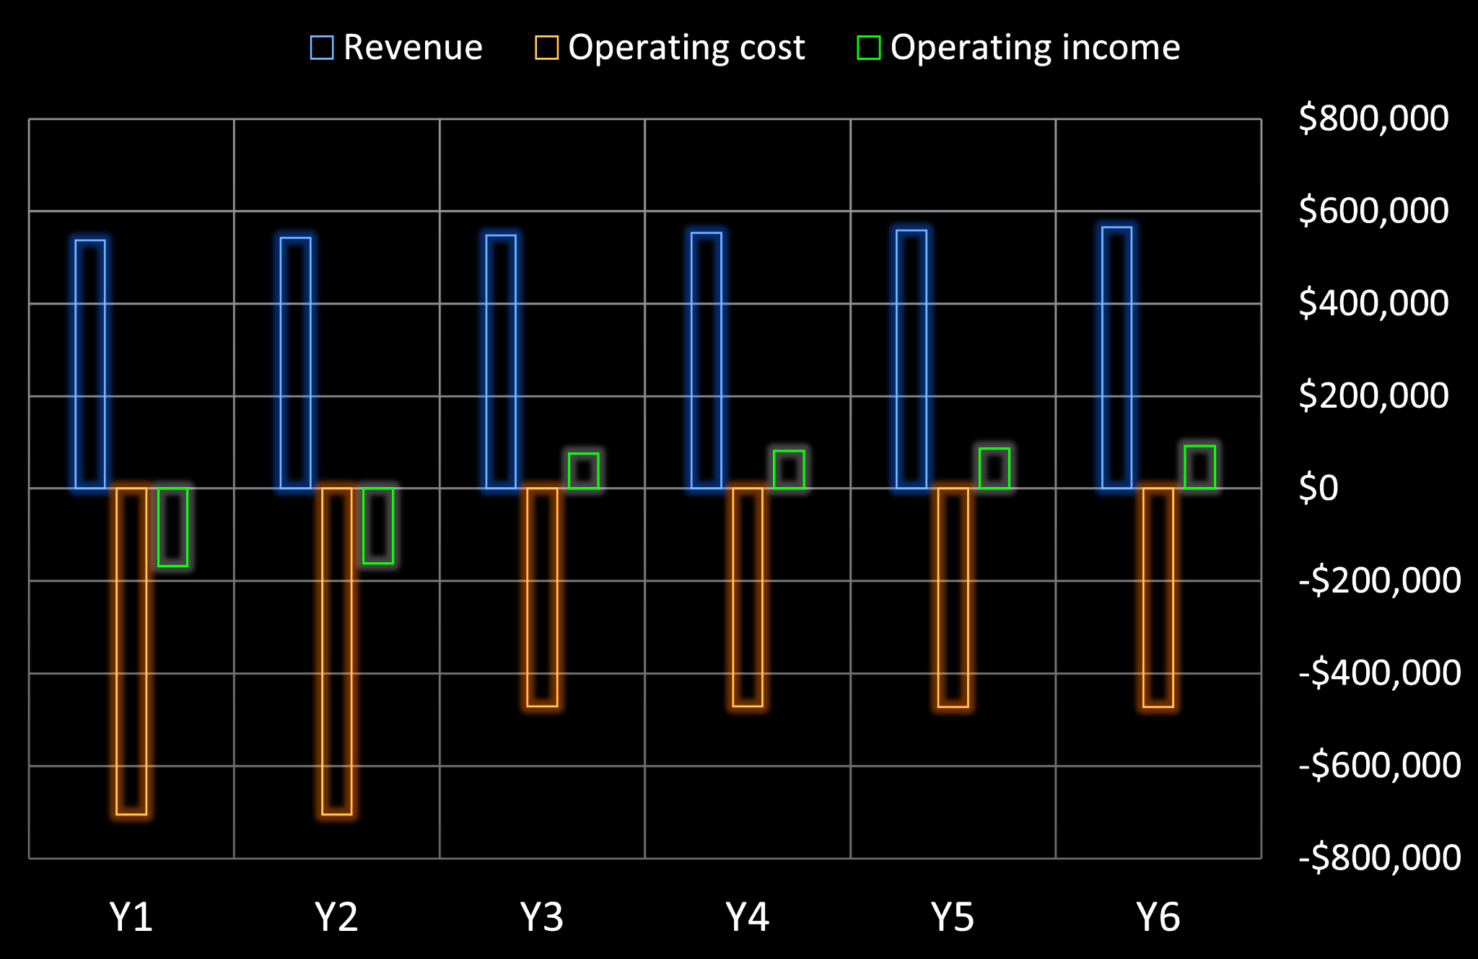
Profit Projection (Pessimistic)
In pessimistic scenario,
• Revenue will stay at half of expected level due to intense competition
• Break-even is reached in Y6
• Staffs are reduced from Y3

Slide 14
However…

Slide 15
A presentation cannot justify the vague but hopeful possibilities of tomorrow. We couldn’t alone imagine all of what tomorrow might hold – but, we took some inspiration…
METAVERSE IS AN ARTISTS PAINTING COME TRUE
Let’s jump in and experience an exhibition of the metaverse

Slide 16
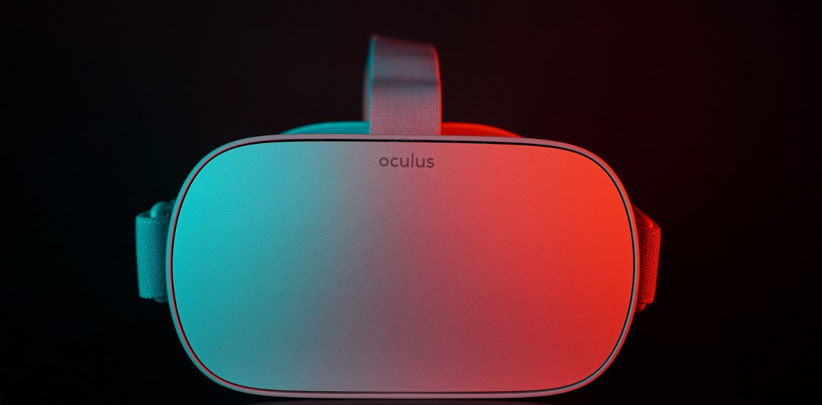
GEAR UP!

Slide 17
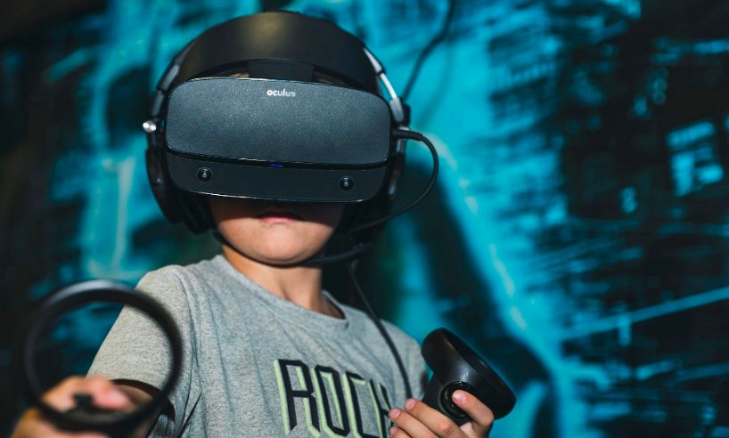
Loading…
Notes:
Put on your VR’s and let us take you on a journey.

Slide 18
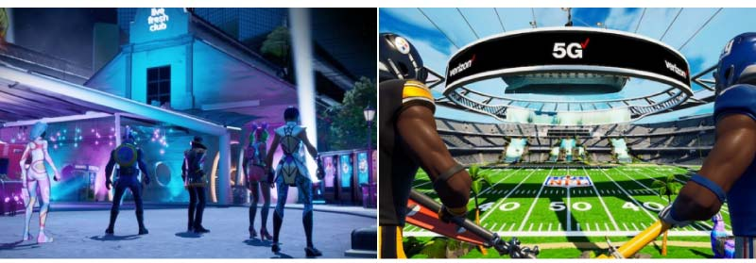
Ford Experience Centre Test Drive Vehicles
Verizon Media
presents
Pittsburgh Steelers vs New York Giants
Notes:
Would you be interested in test driving Ford’s VR showrooms? Or does the big banner in your favorite game catch your eye?

Slide 19
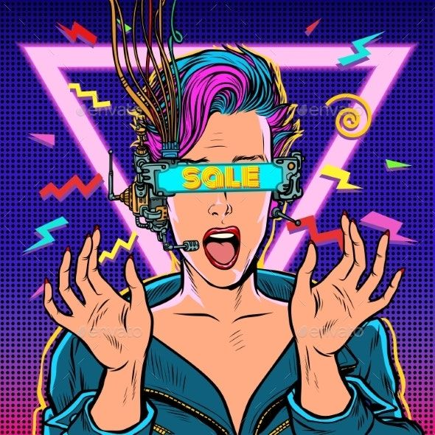
Product Marketing
Notes:
Check out how the ads of the metaverse made her forget about the Skip Ad button.

Slide 20
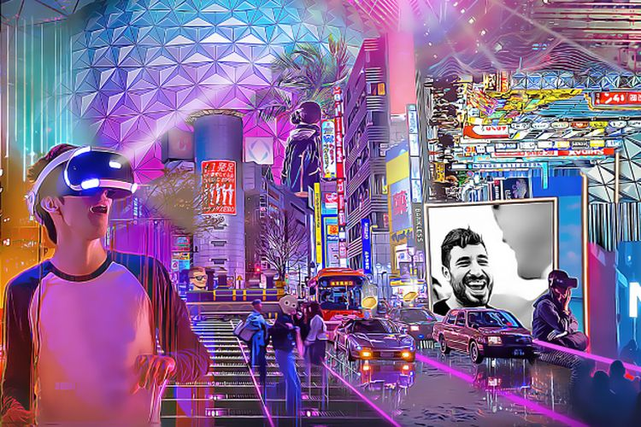
Product Advertisement
Notes:
What if the banners at Times Square showed customized ads tailored just for you? Ads, but make them breathtaking experiences.

Slide 21
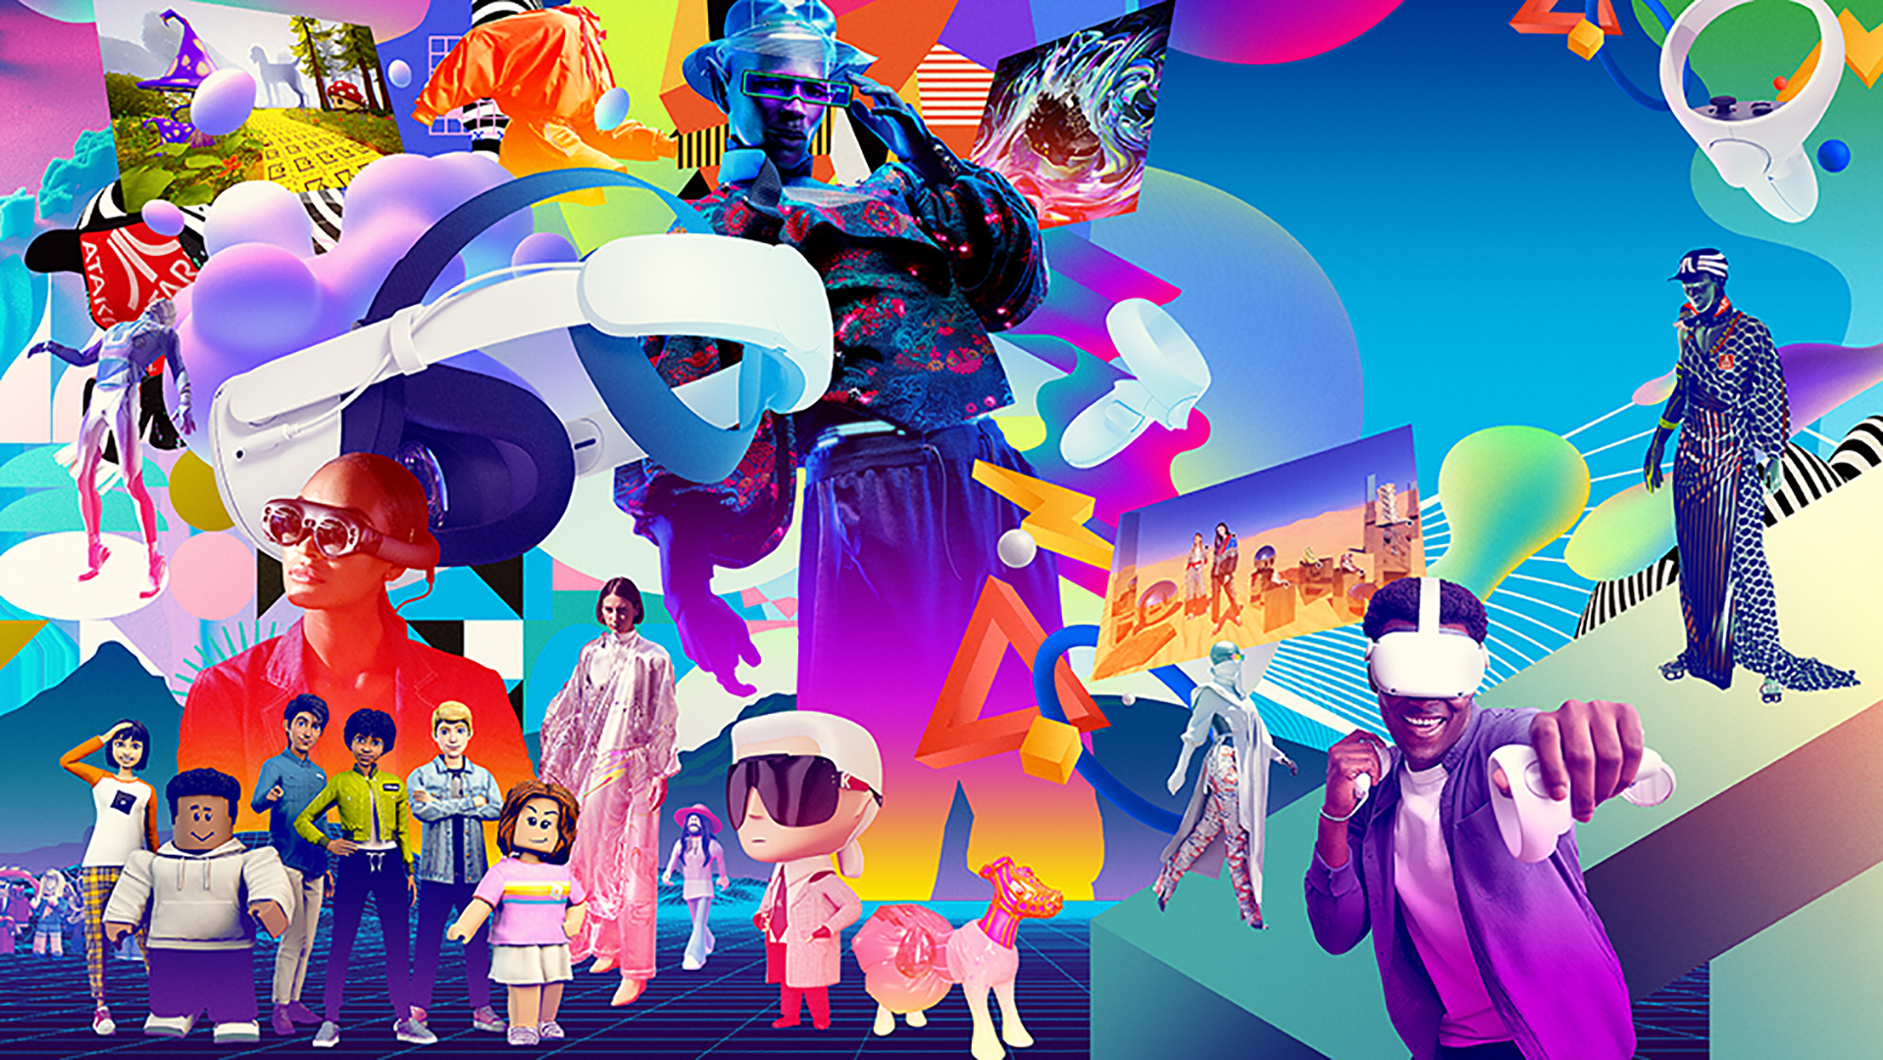

Sephora Fashion Week
Experience Advertisements
Notes:
Want to walk the ramp wearing the latest Louis Vuitton before deciding to buy it?

Slide 22
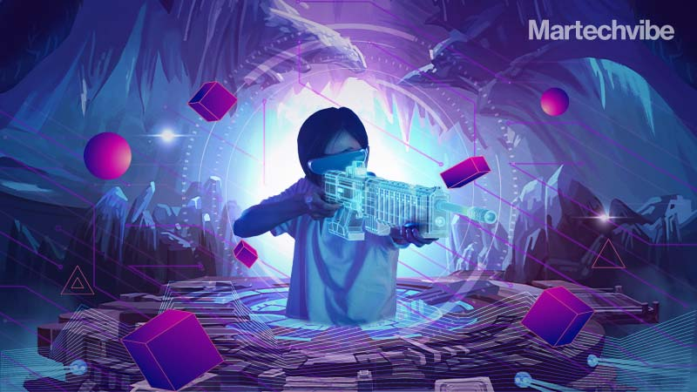
Immersive-Gaming Advertisements
Notes:
Want to get paid to pwn enemies in Call of Duty? Nike might be interested.

Slide 23
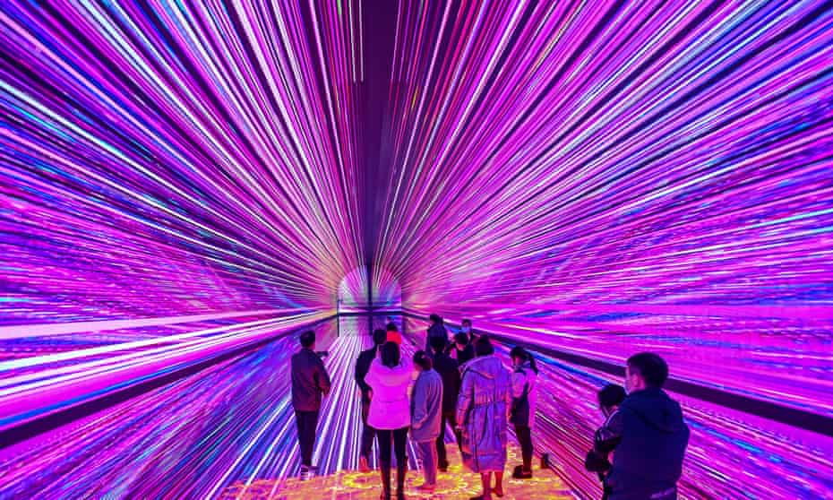
Zipping back into reality…
Notes:
Lets get back to our plain old garden variety real world.

Slide 24
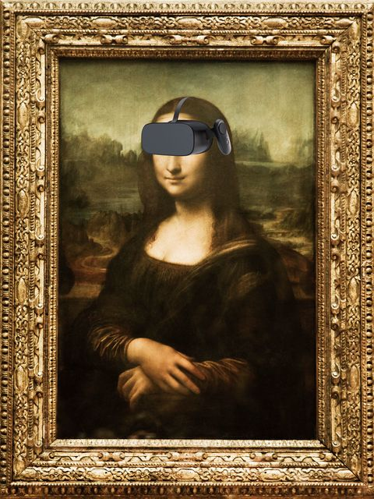
Potential Customer? :)
Notes:
What do you think?

Slide 25
Thank you!

Slide 26
APPENDIX

Slide 27
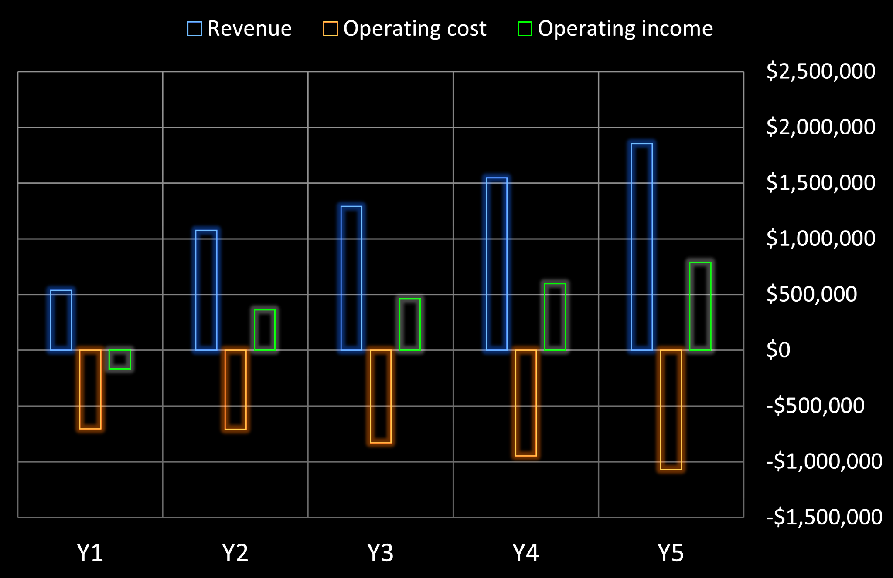
Profit Projection (Optimistic)
In optimistic scenario,
• Business moves on track from Y2, Y1 revenue is half of Y2
• Revenue will grow at 20% annually from Y2 to Y5
• Break-even is reached in Y2

Slide 28
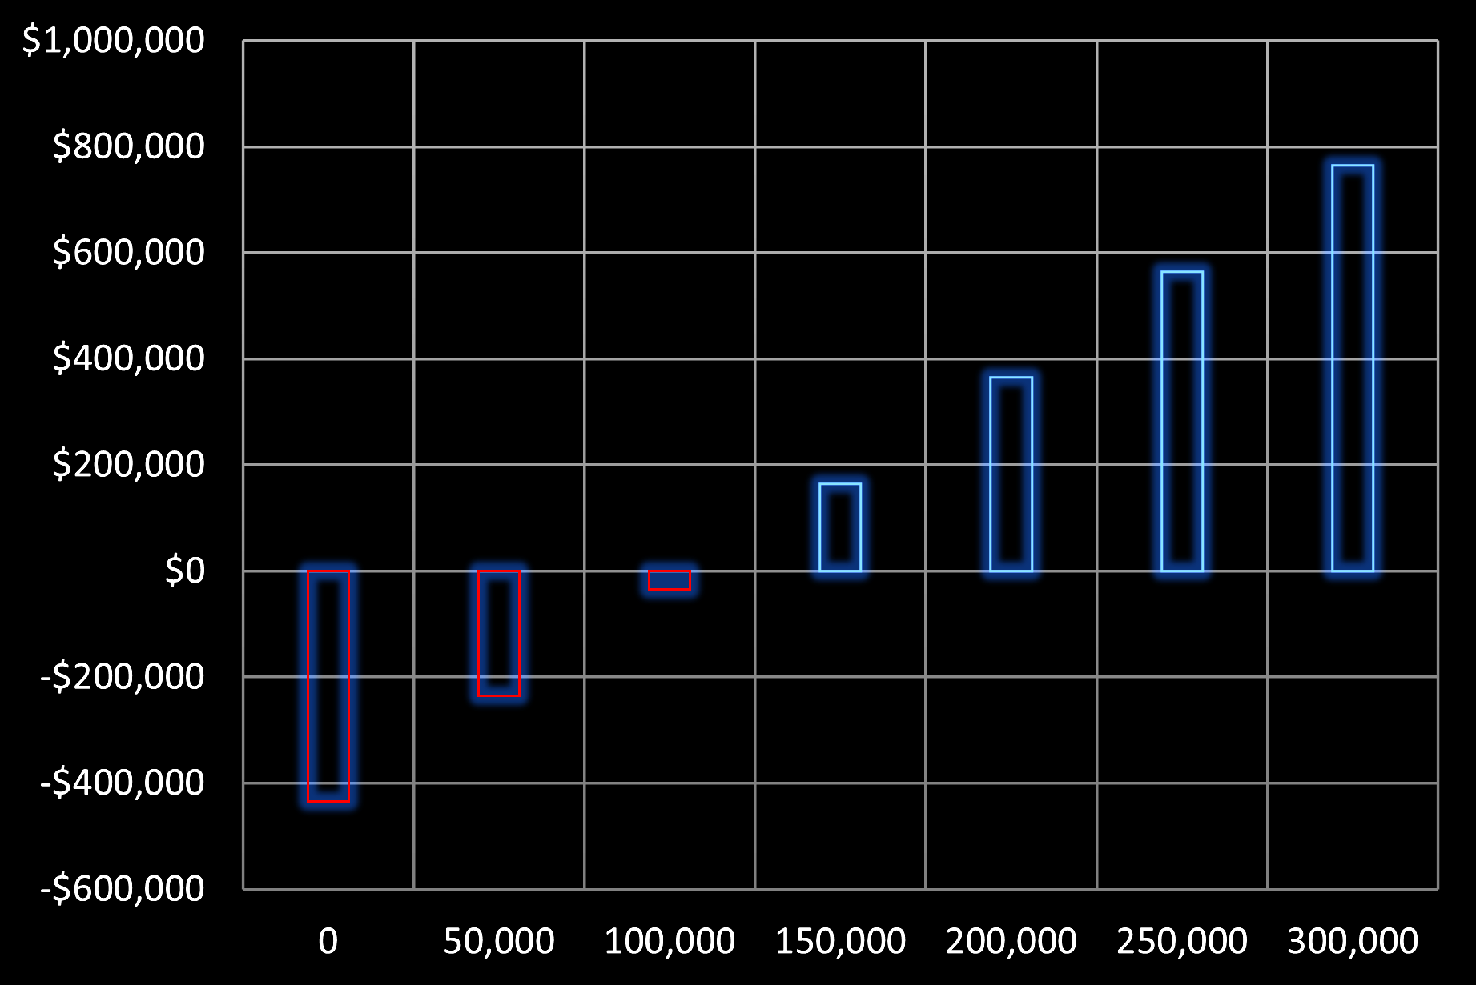
Sensitivity Analysis
• Our profit largely depends on the number of visits.
• By changing # of visits from 0 to 300,000,
• Profit varies from -$435,000 to +$764,000
• Break-even: 110000 visits per game

Slide 29
Profit Projection (Optimistic)
In optimistic scenario,
• Business will on track from Y2, Y1 revenue is half of Y2
• Revenue will grow at 20% annually from Y2 to Y5
• Break-even is reached in Y2

